Slide 1
Hand Gesture Recognition Using Computer Vision
Presented by
Midhun P (TVE17EC027)
Sreejith S (TVE17EC049)
Vipin Chandran M (TVE17EC061)

Slide 2
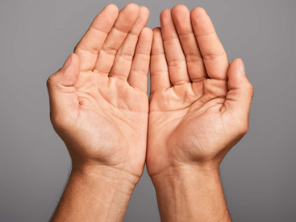
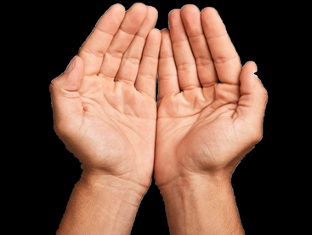
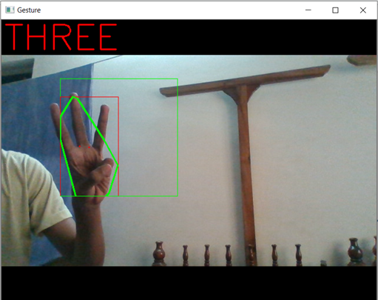
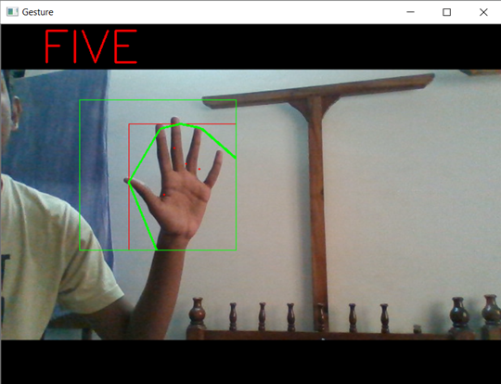
Our Project so far
In the first phase of our project, we were able to detect a hand (the colour of skin) from an image.
Adding onto that, in the second phase, we recognized different hand gestures from a live video.
Phase 1 results
Phase 2 results

Slide 3
Phase 3
Objective –
The intention of phase 3 of our project is to build a virtual mouse which works based on hand movements.
Algorithm – (only additions to phase 2 of the project are mentioned below)
Pynput library allows us to control input devices like the mouse.
The NumPy range for the red color is defined.
Convert BGR to HSV, create the mask and perform morphological operations.
Draw and count the number of contours.
For 2 objects : Release the operation of mouse.
->Make a rectangle around the objects and draw a line between them.
->Draw a circle at the center of the line that will act as a pointer.
->Update mouse location while moving.
For 1 object: Perform left click action.
Display camera and show required images.

Slide 4
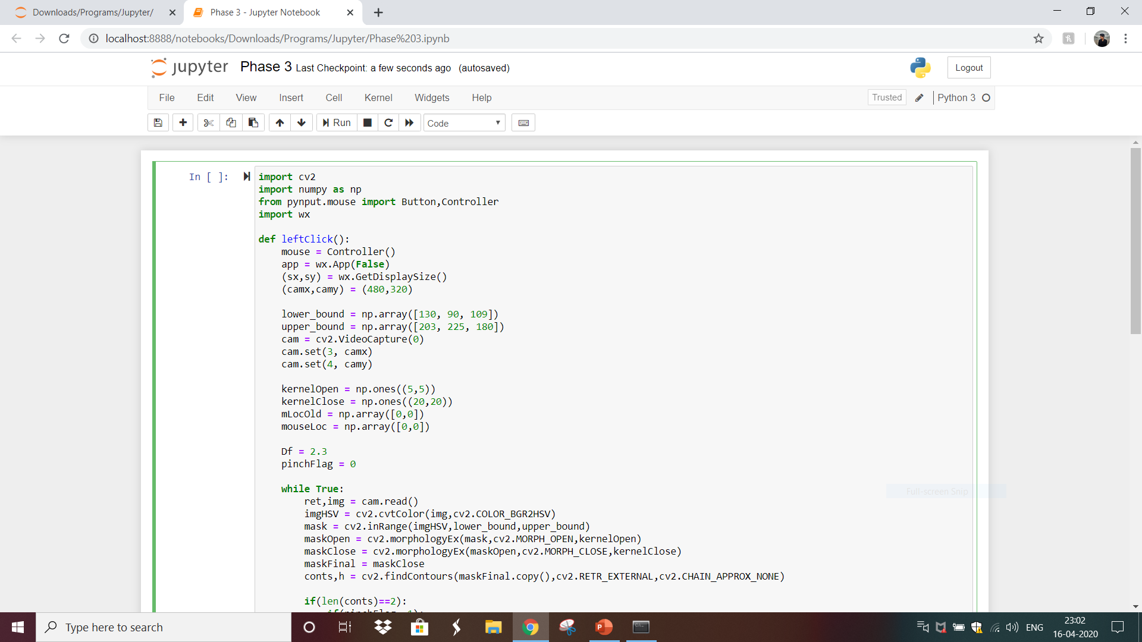

Slide 5
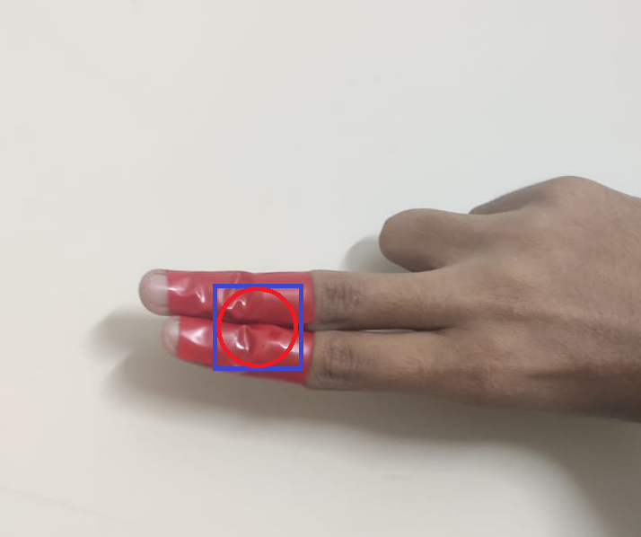
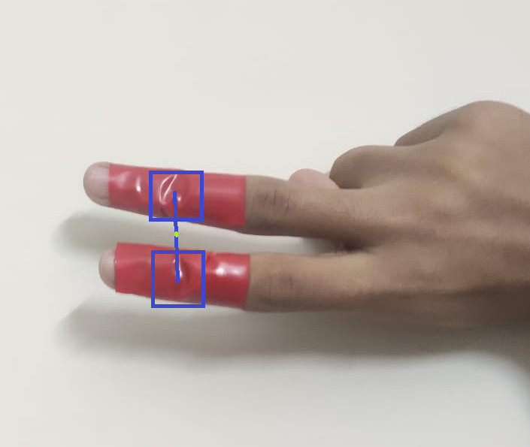
Phase 3 results
Mouse click operation
Mouse pointer
The implementation of our virtual mouse is illustrated in the video file attached.

Slide 6


